Slide 1
Truck fleet Movement - reporting and Analytics
First_Name | Last_Name | Net ID
Prriyamvradha | Parthasarathi | Pxp220005
Rohit | Patil | Rxp220030
Suma Harshini | Samanthula | Sxs210501
Harish | Sathiyanarayanan | Hxs210073
Raghuraman | Shankar | Rxs210139
Rohan | Shivakumar Kalyanshettar | Rxk220059
Veera Veni | Teki | vxt220008
TEAM - 5

Slide 2
AGENDA
Problem Statement & Business Objective
Primary goals
Data Flow
Data Analysis
Challenges
Conclusion

Slide 3
Problem statement
In the US, the occurrence of injuries and fatalities caused by large trucks remains a major concern. Addressing this issue requires an examination and refinement of truck movements, as well as the identification of dangerous commercial transporters through data analysis and Hadoop ecosystems.
By utilizing various factors such as geographic data, vehicle usage, gas consumption, average mileage, accidents, and risk assessment, it is possible to gain a better understanding of potential hazards and improve safety within the transportation industry.
Average no. of cases due to truck incidents in California between 2017 to 2019 – 407
Average settlement amount as a direct result of these incidents in California between 2017 to 2019 - $ 3.34 Million
Source: https://ai.fmcsa.dot.gov/EnforcementPrograms/EnforcementCases/

Slide 4
BUSINESS OBJECTIVE
The primary objective is to identify unsafe commercial transporters nationwide and minimize the frequency of accidents caused by large trucks in the US.
By refining and analyzing trucking movements, the organization aims to enhance safety in the transportation industry and create a more efficient delivery sector. Upon completion of the study, we should be capable of minimizing the risks and costs associated with incidents.

Slide 5
PRIMARY GOALS
Identify the drivers who present a potential risk.
The fleet manager must work to identify drivers who present a higher risk of accidents due to their driving habits, and develop strategies to address these risks, including targeted training and counseling for individual drivers.
Minimize the accidents associated with each driver
Another important objective would be to minimize the count of accidents by identifying and addressing any unsafe driving practices that could lead to accidents or other incidents. This could include tracking drivers' behavior, addressing any patterns of unsafe driving, and implementing training or other measures to mitigate risk.
Identify the optimal truck model
One can consider factors such as fuel efficiency, cargo capacity, durability, and maintenance costs to make an informed decision about the ideal truck model that will help the company achieve its transportation goals effectively and efficiently. The decision will also depend on the types of cargo being transported and the terrain of the routes being traveled. Therefore, a detailed analysis of the company's transportation needs and requirements is necessary to determine the most suitable truck model for the fleet.

Slide 6







PROCESS Diagram
1. Download the data from Internet
2. Store it in on local server in a structured format like csv
ODBC Connector
3. Transfer data from local server to VM
4. Loading data from VM to HDFS
5. Import data in HIVE/IMPALA by Using DDL and Pig script
6. Integrate Hive/Impala with Tableau via ODBC drivers
7. Regression Analysis
20XX
PRESENTATION TITLE

Slide 7
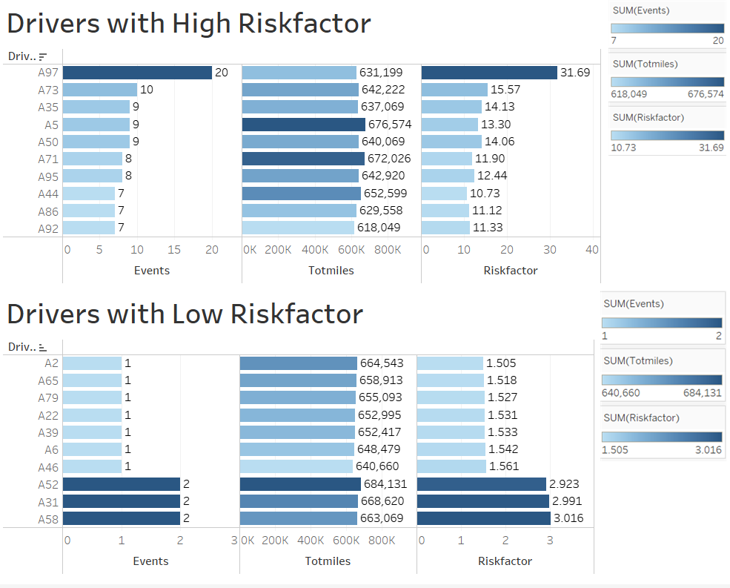
Drivers with high and low risk factor
Identify drivers: The charts can be used to quickly identify drivers who may need additional training or support to improve their driving behaviors and reduce the risk of incidents.
Risk profiles: The visualization provides a clear and concise way for fleet managers and other stakeholders to gain insights into the risk profiles of their drivers and take appropriate actions to improve overall fleet safety.

Slide 8
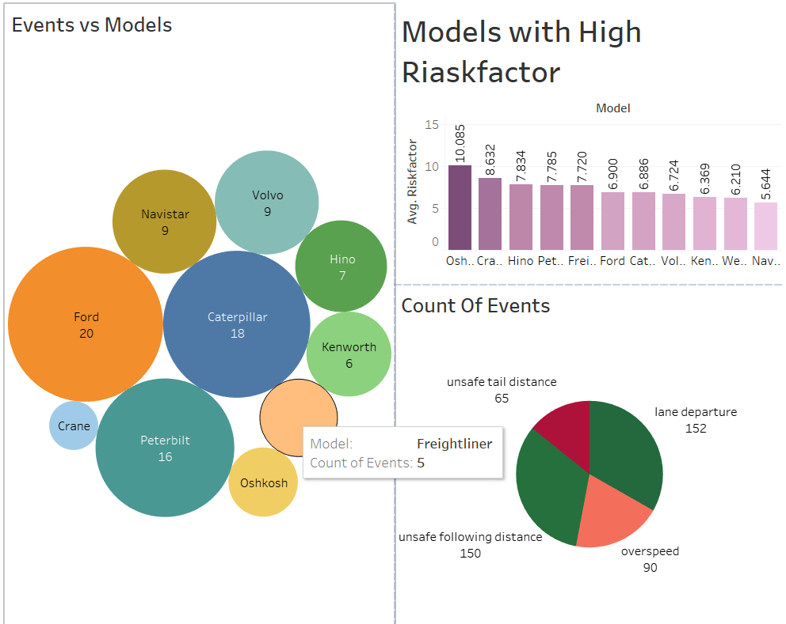
EVENTS AND MODELS
The bubble chart displays various truck models and their associated count of events, with the size of each bubble representing the number of events.
The bar chart arranges all truck models according to their high average risk factors, allowing fleet managers to identify models that may need additional attention to reduce risk.
The pie chart displays the count of events by truck model, providing a clear visual representation of the relative frequency of events across different models.
These charts offer a comprehensive view of the risk profiles of different truck models and can inform data-driven decisions to improve overall fleet safety.

Slide 9
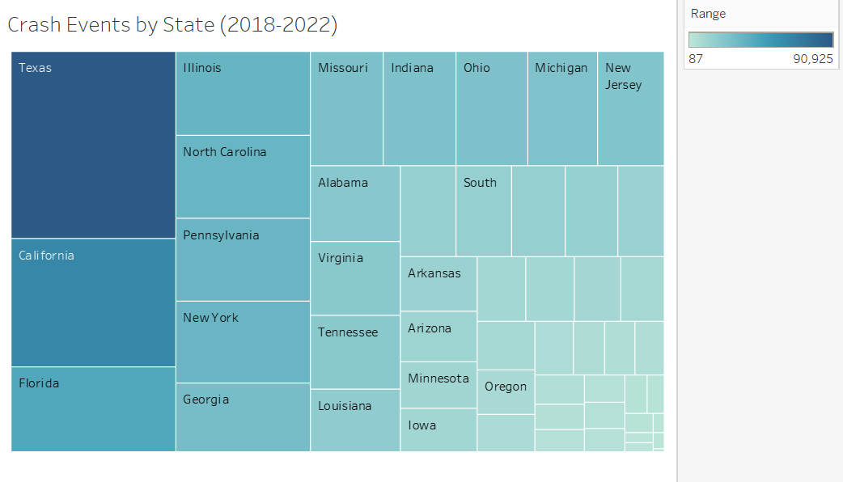
Geographic analysis – Incidents across the U.S
Summary statistics for Large Trucks in United States based on the MCMIS data source covering Calendar Year(s) 2018-2022 for all crash events.
California experienced the second-highest number of crash events in the United States, with a total of 62,427 crashes, out of which 1,973 were fatal and 60,454 were non-fatal.
California had 3.16% fatalities while the US national average was 2.6% fatalities.
https://ai.fmcsa.dot.gov/EnforcementPrograms/Inspections

Slide 10
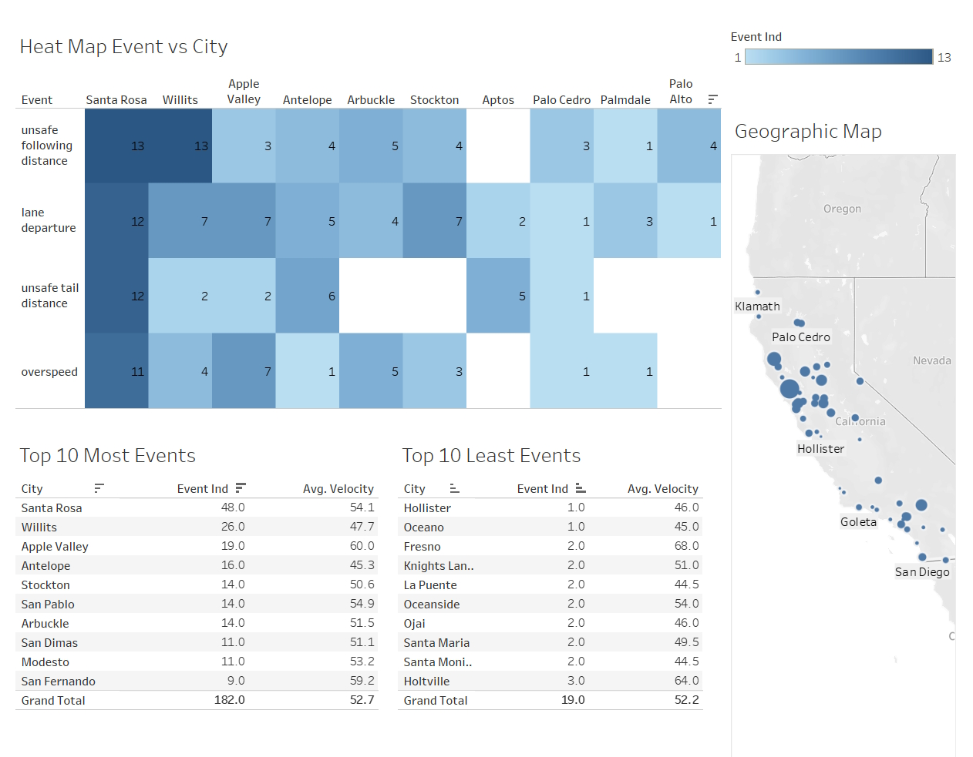
Geographical Analysis: Events across cities
Terrain: North-Western California terrain is mountainous hence it is challenging to drive in this region.
Reduce Velocity: Lower Truck velocity in challenging conditions would improve the control and may lead to lesser events.
Training: Design a driver education program considering the challenges drivers face in these cities, incentivize good drivers.

Slide 11
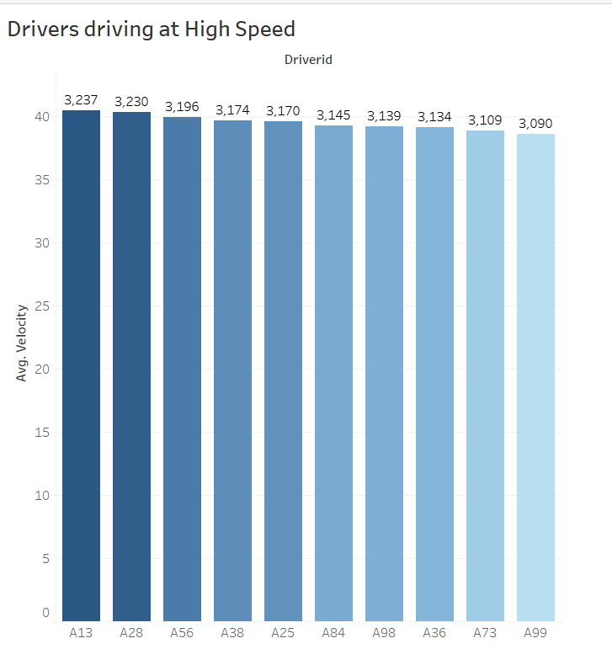
Drivers driving at high speed
This visualization helps with identifying the top 10 drivers who drive the fastest and their average speeds.
The driver with ID A13 is recognized as the one who drives at the fastest speed based on the company's average velocity calculation.
This visualization reveals which drivers need to be cautioned about exceeding the speed limit and given training to refrain from doing so.

Slide 12
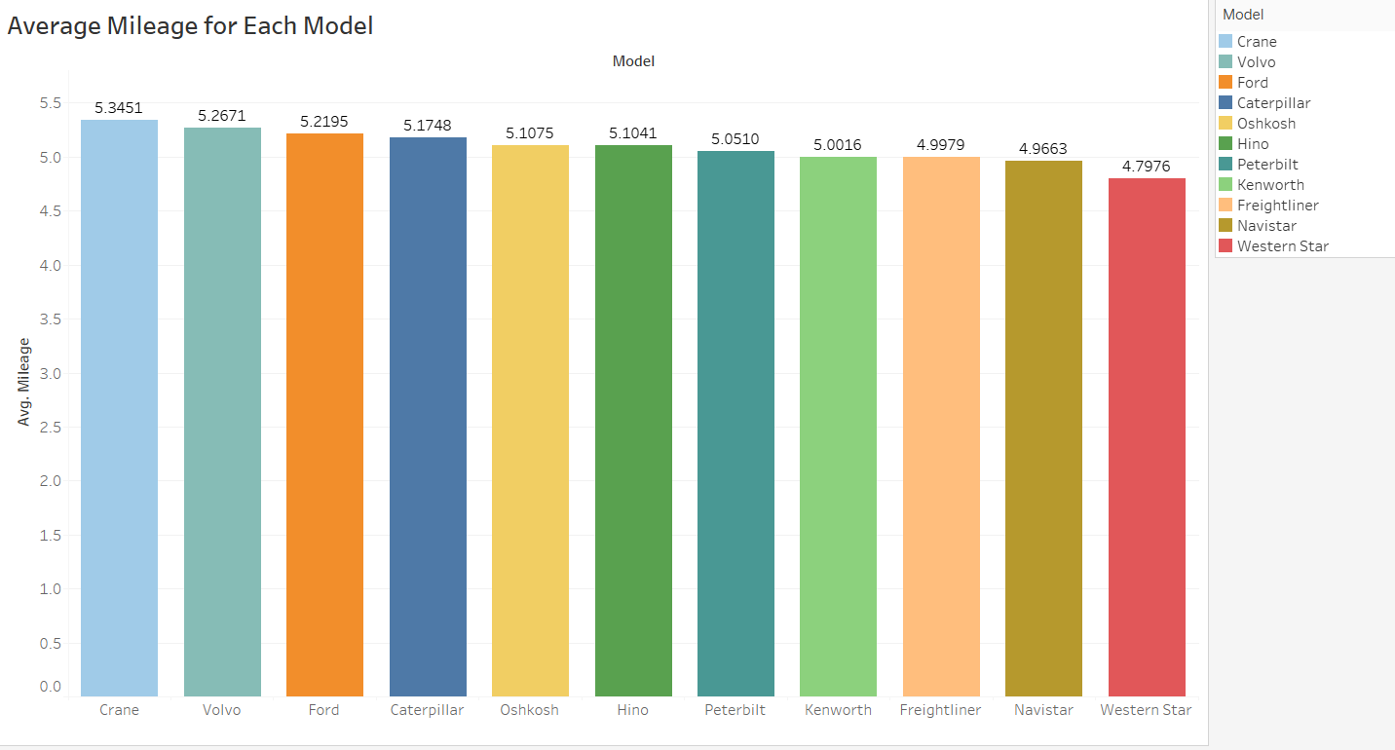
AVERAGE MILEAGE FOR EACH MODEL
This visualization provides an analysis of the mileage of each model of truck. This helps to identify the economic value of owning these models in the fleet.
Crane, Volvo and Ford trucks were among the most economical of the fleet.
Navi star and Western Star were among the least.

Slide 13
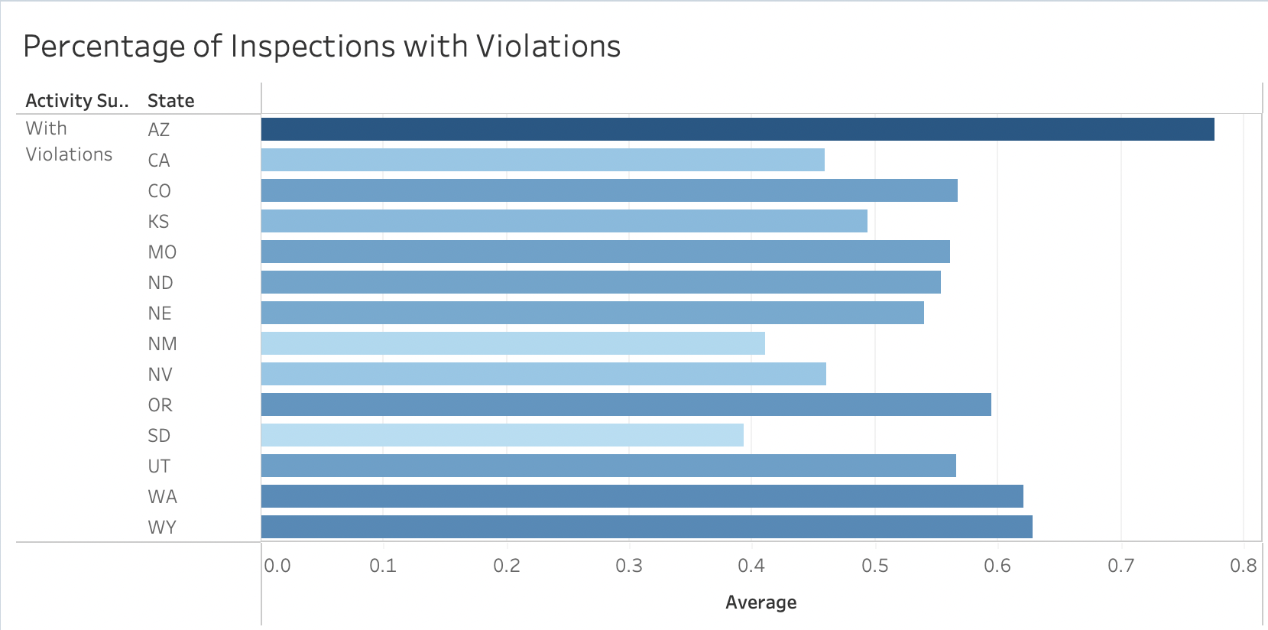
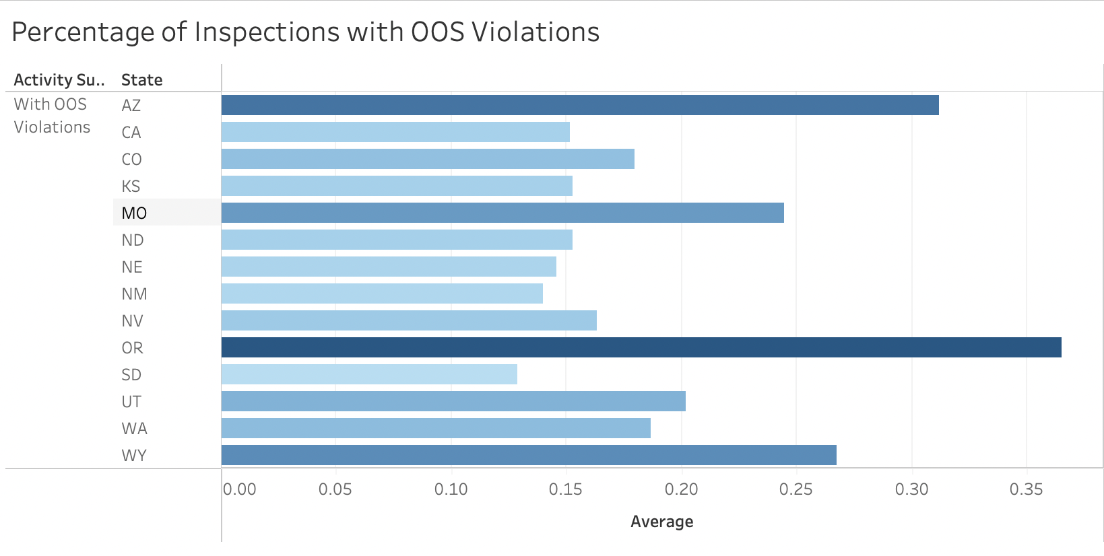
Road inspections and percentage of violations
https://ai.fmcsa.dot.gov/EnforcementPrograms/Inspections
An analysis of the inspections conducted by the federal and state government across 14 states for trucks indicated that a minimum of 39% of the inspections had violations and 13% of these inspections were found to be OOS (Out of Service) violations
An OOS (Out-of-Service) violation is a serious violation that is identified during a roadside inspection and requires a commercial motor vehicle (CMV) or driver to be immediately removed from service until the violation is corrected.

Slide 14
Logistic Regression
Objectives: To identify the variable(s) that have a significant impact on the occurrence of accident events
Dependent variable: Event_ind
Independent variables: velocity, Risk factor, Model_te, city_te
Findings of the study: Velocity and Total miles had the highest contribution to the number of events caused in accidents.
The results can be used to develop strategies for reducing the number of accidents
Limitation: Further research can be done to validate the findings and explore other variables that may influence the occurrence of accident events.

Slide 15
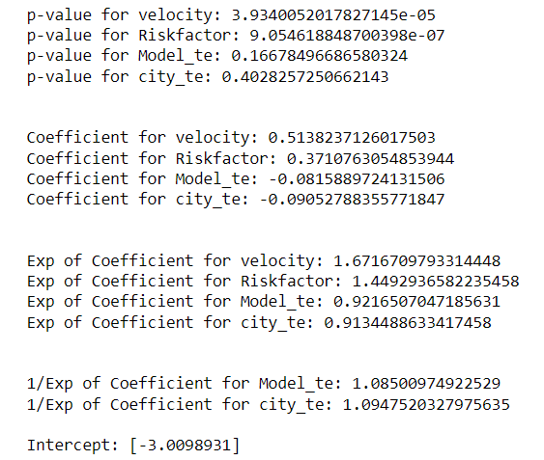
Logistic Regression
The p-values indicate the significance of each variable in predicting the target variable. Velocity and Risk factor are highly significant predictors, while Model_te and city_te may not be significant.
The coefficients indicate the effect of each variable on the target variable. Velocity and Risk factor have positive coefficients, while Model_te and city_te have negative coefficients.
The exponential of the coefficients provides us with the odds ratio, which shows how much more (or less) likely the target variable is to occur with a unit increase in the predictor variable. Velocity and Risk factor have odds ratios greater than 1, indicating they are significant predictors, while Model_te and city_te have odds ratios close to 1, indicating they may not be significant predictors.
The inverse of the exponential of the coefficients for Model_te and city_te provides us with the percentage change in the odds of the target variable occurring for a unit increase in the predictor variable. Both Model_te and city_te are associated with a 1.09% decrease in the odds of the target variable occurring.

Slide 16
Challenges
In the Geolocation dataset, the Event Indicator column had values as 1 even though the Idle Indicator was 1 and the velocity was 0. Events like lane departure happened when velocity was 0. This had to be ignored for the purpose of analysis.
Choosing between relationship and joins in Tableau to accurately create the required visualizations without duplicates.
Creating a calculated field for the mileage of each model based on 3 years of data for the miles and gas used by each truck
Finding relevant data to enrich our current data to accurately determine the effects on the business model. A lot of data in websites was available only in summary form or confidential and accessible only by government workers.
When constructing the logistic regression model, it was necessary to thoroughly examine the variables that would be used as predictors and response. Various considerations such as the statistical significance of the data (p-value), the goodness of fit of the model (R-squared value), and confounding variables had to be taken into account. These factors needed to be carefully evaluated to ensure the reliability and validity of the model in predicting the outcome variable.

Slide 17
SUMMARY & Recommendation
Mandate lower truck velocity in Northwest California as it is a challenging terrain
Design a detailed screening test that scrutinizes the qualifications, past history of a driver before employment.
Design a driver's education program for existing drivers in the company by identifying their weak areas and improving them through a simulator.
Ensure to have robust insurance policies for drivers and trucks that can minimize the costs associated with lawsuits and settlement
Incentivize drivers that maintain the optimum required speeds and low risk factor in specific regions to reduce incidents.
Crane, Volvo and Ford Truck models have high mileage and need to be incorporated in the fleet, while Western Star needs to be phased out to save costs.

Slide 18
THANK YOU!

